Slide 1
Capstone Project
NYC Taxi Trip Time Prediction by Debanjan Ganguly Data Science Trainee AlmaBetter, Bengaluru

Slide 2

Prediction of Yellow Taxi Service estimated time duration using Machine Learning Approach
Introduction
_________________________________________________________
Most of the ride service providing company faces a common problem of efficiently assigning the rides to passengers so that the service is smooth and hassle free.
With accurate prediction comes accurate allocation, results as less waiting time which means less cancellation from client side and increase in profit margin, as well as customer base.

Slide 3
id unique id
Dataset Information
(1458644, 11)
pickup_datetime timestamp of pickup
vendor_id unique id for trip provider
dropoff_datetime timestamp of dropoff
passenger_count no. of passenger riding
Null count: 0
trip_duration duration of trip in seconds
Category Column:
store_and_fwd_flag (Y, N)
vendor_id (1, 2)
pickup_latitude lat. Of pickup location
pickup_longitude long. Of pickup location
dropoff_longitude long. Of dropoff location
store_and_fwd_flag store and forward record or not
dropoff_latitude lat. Of dropoff location

Slide 4
Data Wrangling : Check for null values, removed outlier EDA : Exploratory Data Analysis of features, target to extract piece of information Modelling : Encode categorical variables, create new features from existing and standardizing data Split data and train the model Evaluate the model against validation set with mse, rmse, r2 score etc error metrics
Data Pipeline

Slide 5
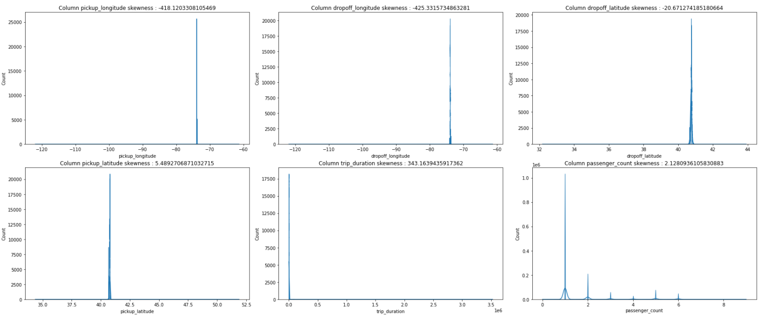
Extreme skewed distribution
Distribution of Features

Slide 6
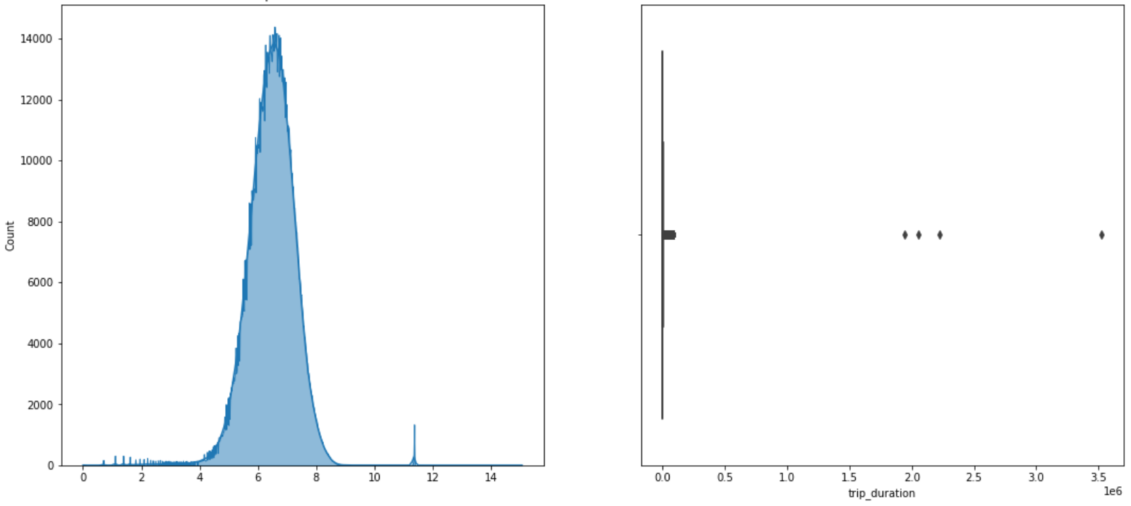
Target Distribution (Log Scale)
Most of the trips between ~54 sec (exp 4) and 82 mins (exp 8)
Normal Distribution in Log Scale
Clear outliers visible

Slide 7
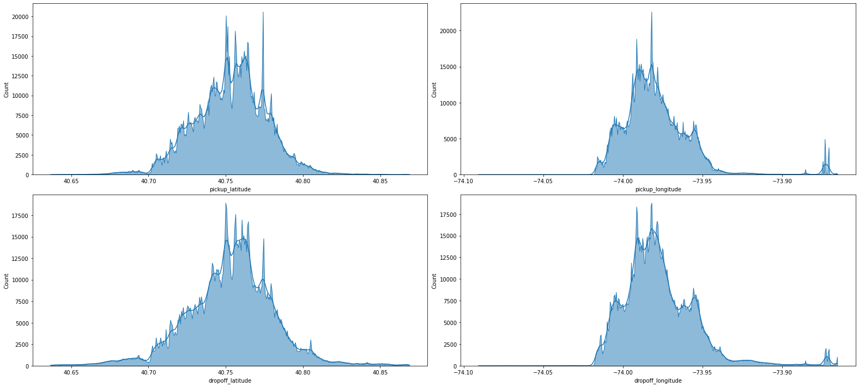
Distribution of Co-ordinates
Latitude distributes within 40 to 41
Longitude distributes within -74 to -73

Slide 8
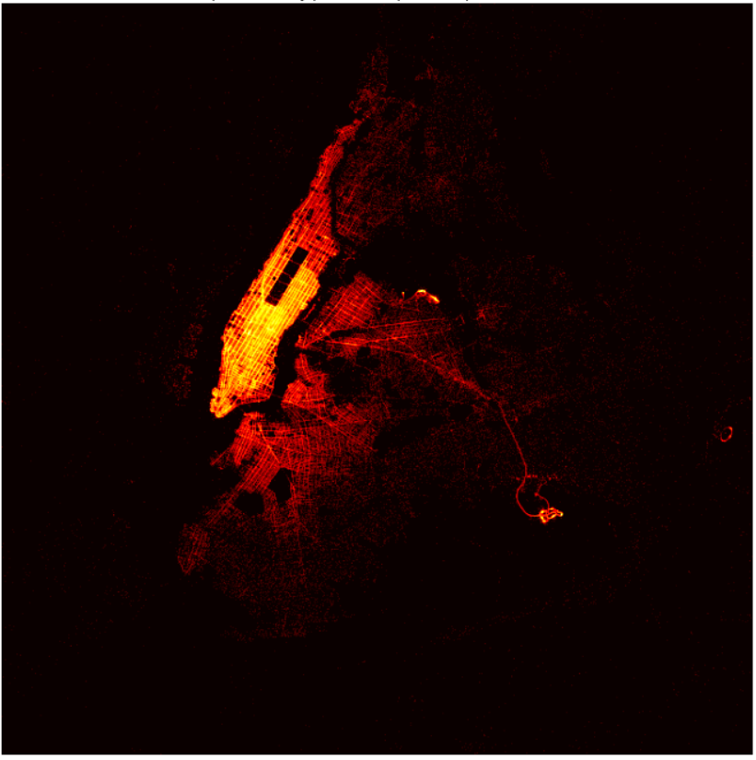
Spatial Density Graph
of Location

Slide 9
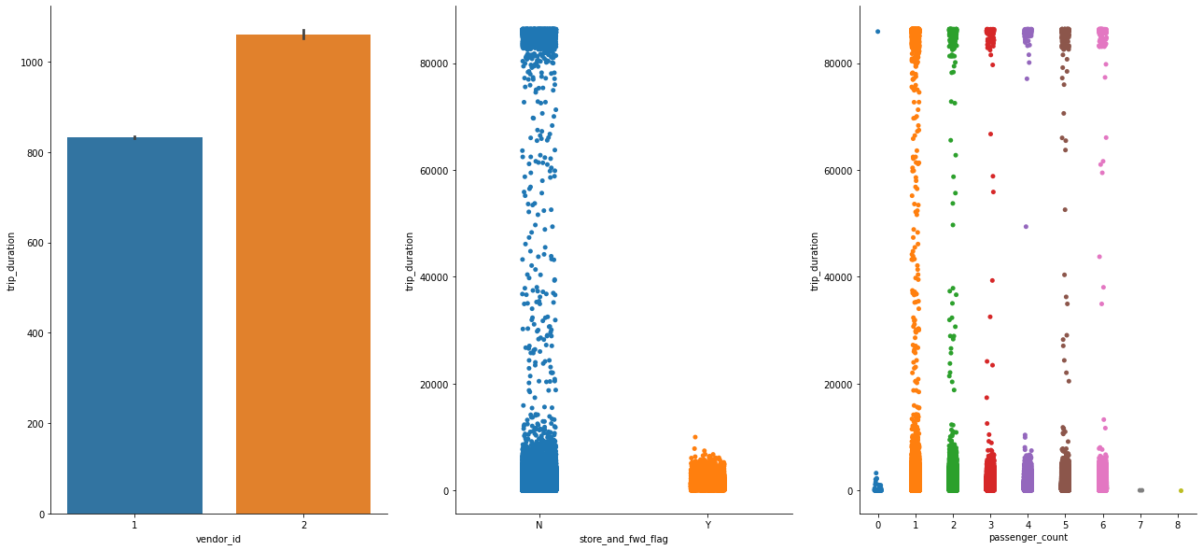
Bivariate Analysis on Target
Vendor 2 seems to prefer longer trips
Most the ride has connectivity to server
Several Rides with 0 Passenger

Slide 10
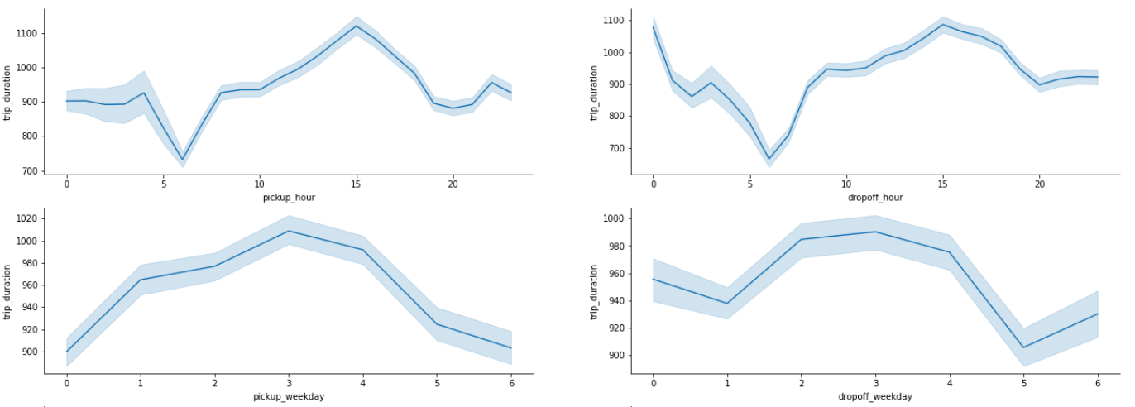
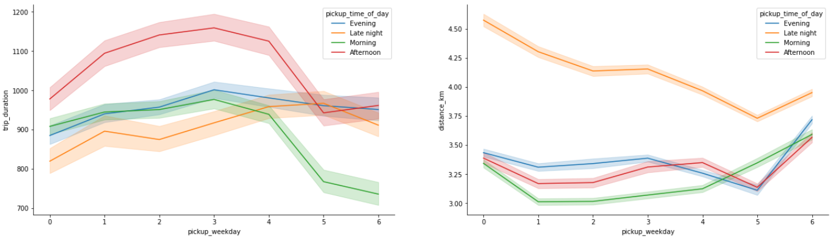
Bivariate Analysis of against Datetime
High requests from middle of day
Highest duration on middle of weeks
With more distance travelled, trip duration on midnight is relatively low

Slide 11
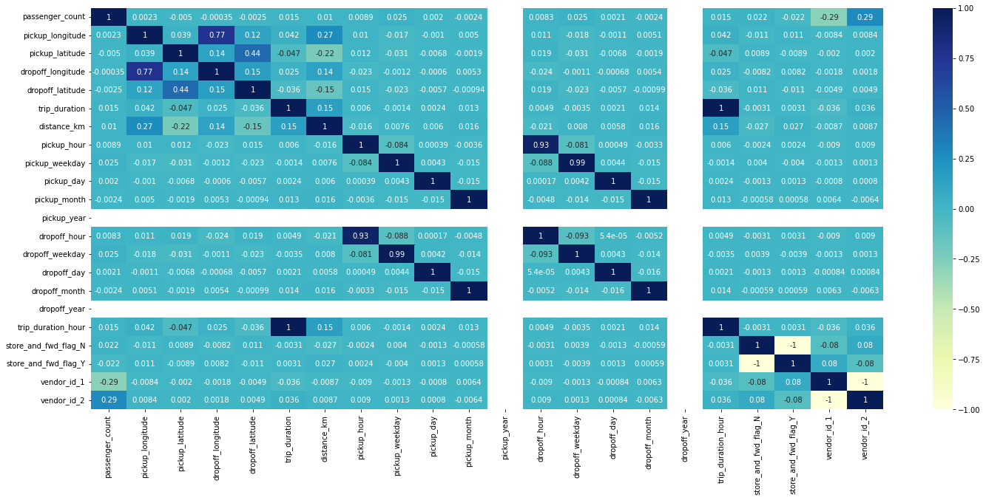
Correlation Matrix
Highest correlation for target is with distance_km i.e. -0.15

Slide 12
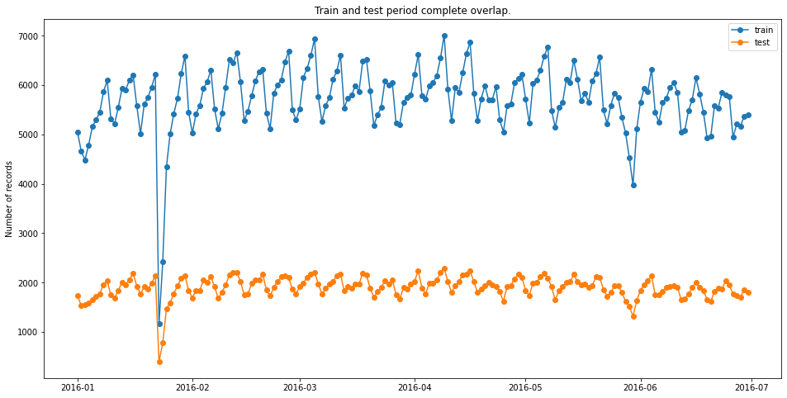
Comparison of Train-Test
Train Set : 1039279
Test Set : 346427
Validation Set : 72932

Slide 13
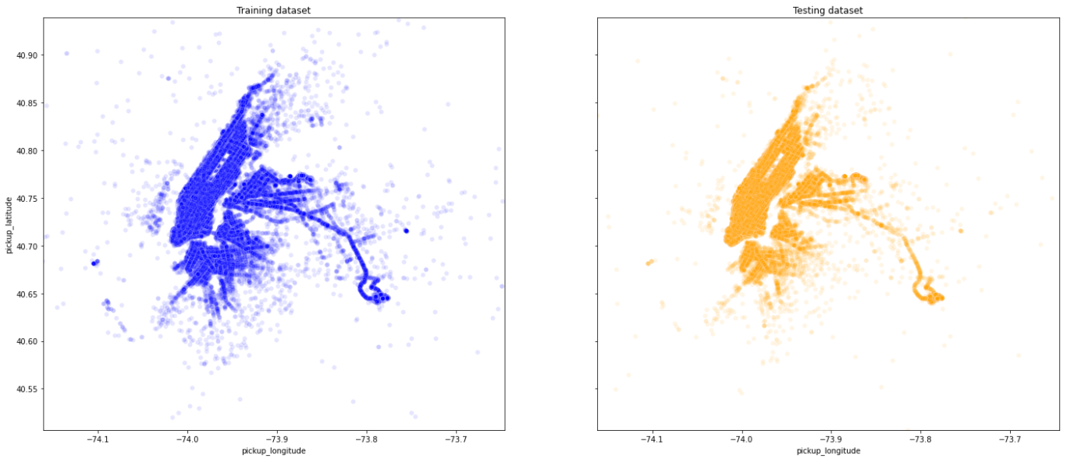
Scatterplot of Train - Test Data

Slide 14
Linear Regression and Lasso Ridge returning score with 0.30 – 0.34 range
Model Selection
Decision Tree Regressor is slightly better with avg training score of ~0.45
Best r2 score ~0.7756
Obtained on LightBGM
Random Forest outperforms all previous score, set new best score of ~0.80 but at a extensive computational cost
LightGBM as expected gives quite similar or better performance with a score of 0.89 and 0.77 on training and testing set respectively

Slide 15
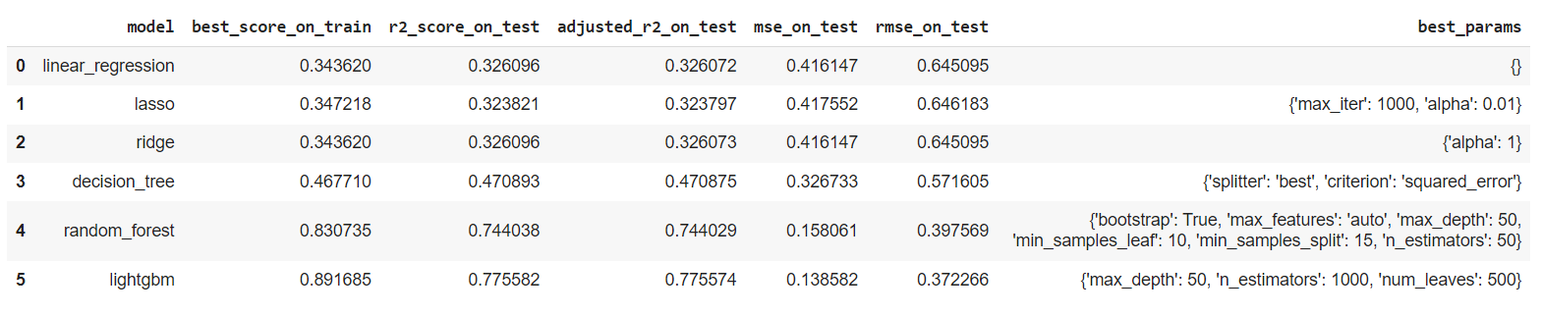
Model Evaluation
Best r2 score ~0.7756
Obtained on LightBGM
Best parameter on LightBGM is
max_depth 50
n_estimators 1000
num_leaves 500
Best rmse score ~0.3721
Obtained on LightBGM
Model tends to overfit with large number of estimators or large sample splits

Slide 16
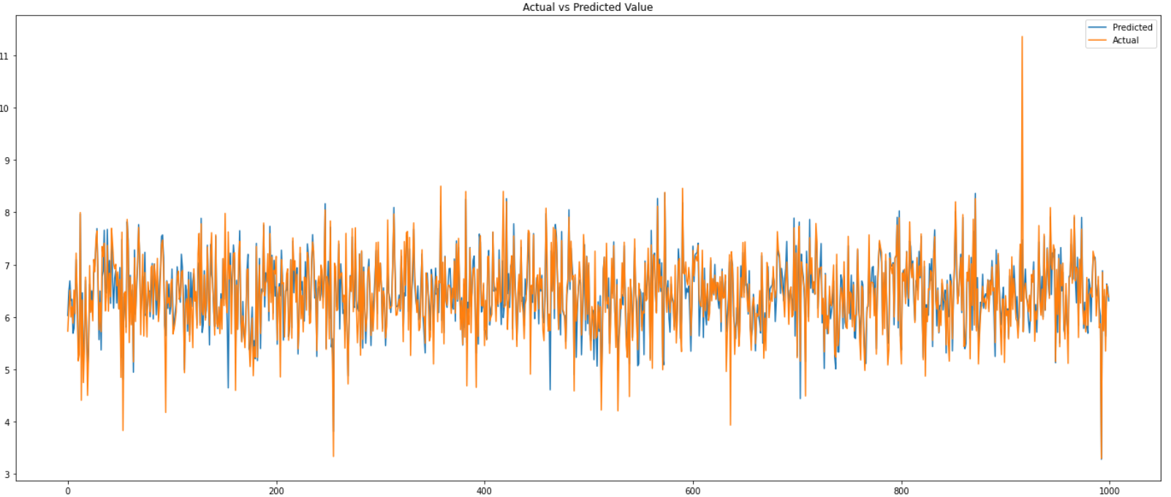
Actual vs Predicted Value
Plotted from the predictions of 72932 validation data

Slide 17
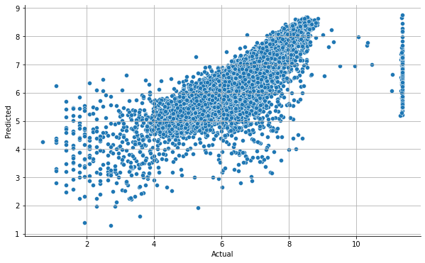
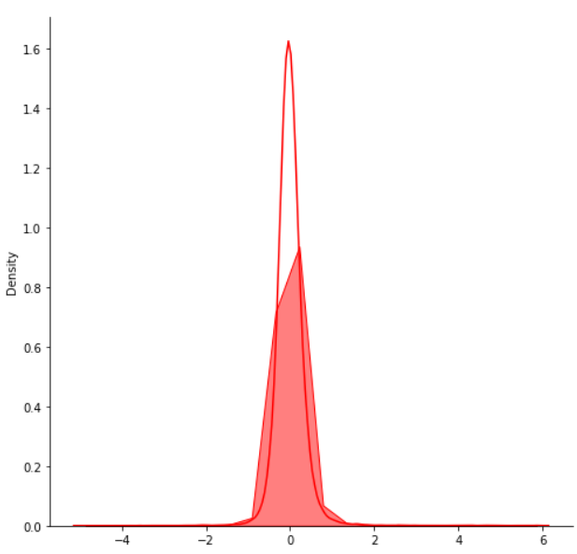
Model Evaluation
Plots with predicted Values
Residual Analysis

Slide 18
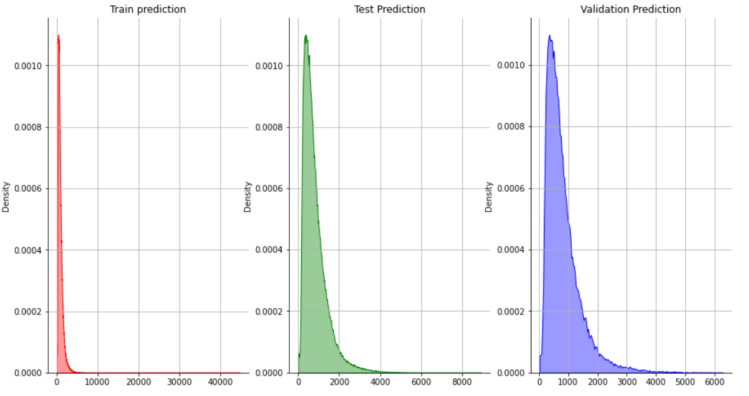
Histplot for density of predictions from all datasets

Slide 19
Limitation
Real world data can be and is a messy one, it's also a no exception in our dataset. In our case, data as it was very raw, and we needed to clean it first to move further. It has many anomalies we noticed about the time duration and distance travelled, though we've removed it but still many more is present there, we live it as it is to add a bit noise.
We don't have proper information of traffic and season, that'd be a great addition in this dataset. Also, the rating of cab or driver would also do great, people normally provide better rating with clean driving and punctuality in rush hours.

Slide 20
Challenges
With over 14 lakhs row presents, handling a huge chunk of data is a challenge itself. Also, the memory usage of this pile of data is very high so there’s chance of the system to run out of memory during model training or some advance plotting
The computation time and cost both are relatively high
The dataset contains many obvious outliers and noise

Slide 21
Scope of Improvement
We can add more features to our dataset, like ratings, driver’s ability on some scale or experience (experienced driver is normally better at driving than newbies), seasons information or can feed live traffic data. Also, more extensive EDA is required with help of external datasets
Try out XGBoost model, done hyper parameter tuning over XGBoost model. XGBoost always gives more importance to functional space when reducing the cost of a model while Random Forest tries to give more preferences to hyperparameters to optimize the model. Also we need to perform PCA to reduce dimensions.

Slide 22
Conclusion
We've achieved r2_score > ~0.78 on validation set, though it is not that much of good, especially when we scale prediction from log to normal scale, noise will be too high, but still, we have scope of improvement with addition of few other features (can be from other sources to merge with), more accurate hyper parameter tuning, using XGBoost or performing PCA etc.
Almost all long delays happen for the cab of vendor 2, even though vendor 2 has only a slightly higher percentage of rides overall. This discrepancy is definitely significant enough to explain most of the effect.

Slide 23
Conclusion
Driver’s ability can be an important factor some drivers got higher skills comparatively than others, so trip duration can also vary with driver's ability as well.
Outside of Work hours traffics are relatively low, majority of trips are fast.
sklearn CV options (RandomizedSearchCV or GridSearchCV) for usual mid-to-large dataset the training for a single model could take hours, also reducing memory is another challenging

Slide 24

Thank You
As part of EDA Capstone Project by

